Slide 1
BIOS 611 Final Project
Urban Ministries of Durham
Yuxiao Yao

Slide 2
Background
Non-profit Urban Ministries of Durham (UMD) connects poor and homeless neighbors to food, shelter and a future. They connect with the community to end homelessness and fight poverty by offering food, shelter and a future to neighbors in need.
This project is aiming to help the UMD to improve their services and get prepared for future works.

Slide 3
Datasets
Datasets are provided by the UMD, including clients’ information, entry and exit information, clients’ health insurance conditions, income conditions and disability conditions at entry and at exit, provider information. Some variables are shown below:
CLIENT: Client ID, Client Age at Entry, Client Gender, Client Primary Race, Client Ethnicity, Client Veteran Status
ENTRY_EXIT: Entry Date, Exit Date, Destination, Reason for Leaving
EE_UDES: Client Location, Relationship to Head of Household, Prior Living Situation, Length of Stay in Previous Place
HEALTH_INS_ENTRY: Covered (Entry), Health Insurance Type (Entry), Health Insurance Start Date (Entry)
HEALTH_INS_EXIT: Covered (Exit), Health Insurance Type (Exit), Health Insurance Start Date (Exit)
INCOME_ENTRY: Receiving Income (Entry), Income Source (Entry), Monthly Amount (Entry)
INCOME_EXIT: Receiving Income (Exit), Income Source (Exit), Monthly Amount (Exit)

Slide 4
Questions
Demographics
What are characteristics of the client population at entry?
What are their health insurance and income conditions at entry and at exit?
Entry and Exit
How many clients were served by the UMD? What is the distribution of their entry time?
How long did they stay at the UMD?
Why did they leave the UMD?

Slide 5
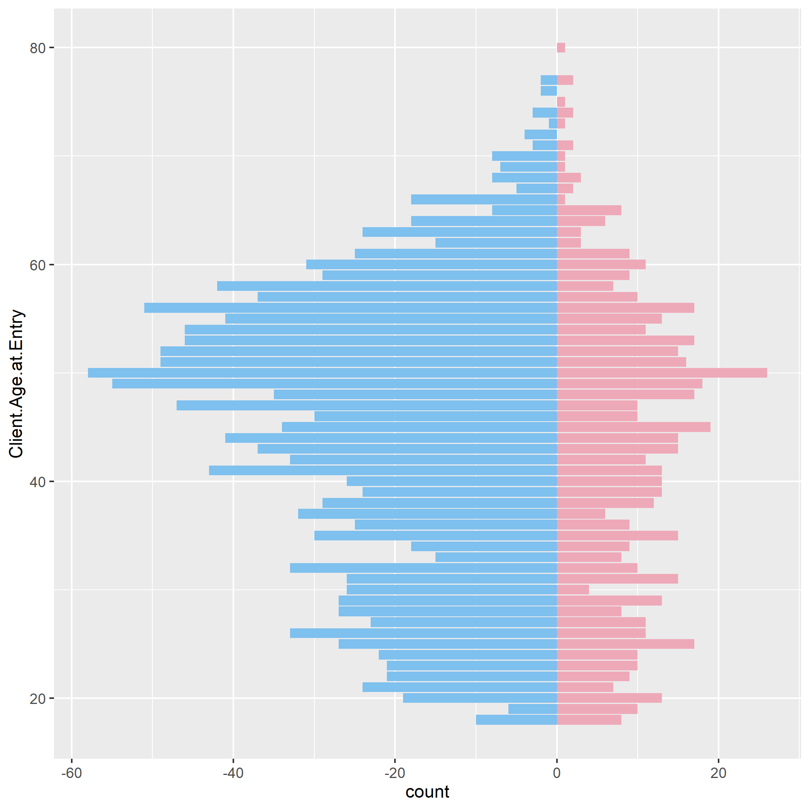
Demographics - Gender & Age
Blue: Male
Pink: Female
Apparently, men are more than women in the client population. Ages of clients varies from 18 to 80. Most of clients are around 50-60. The distribution of different ages for men and women are similar: the number the old people who are more than 60 years old is relatively small, and there is a generally decreasing trend as the age goes down from 50.

Slide 6
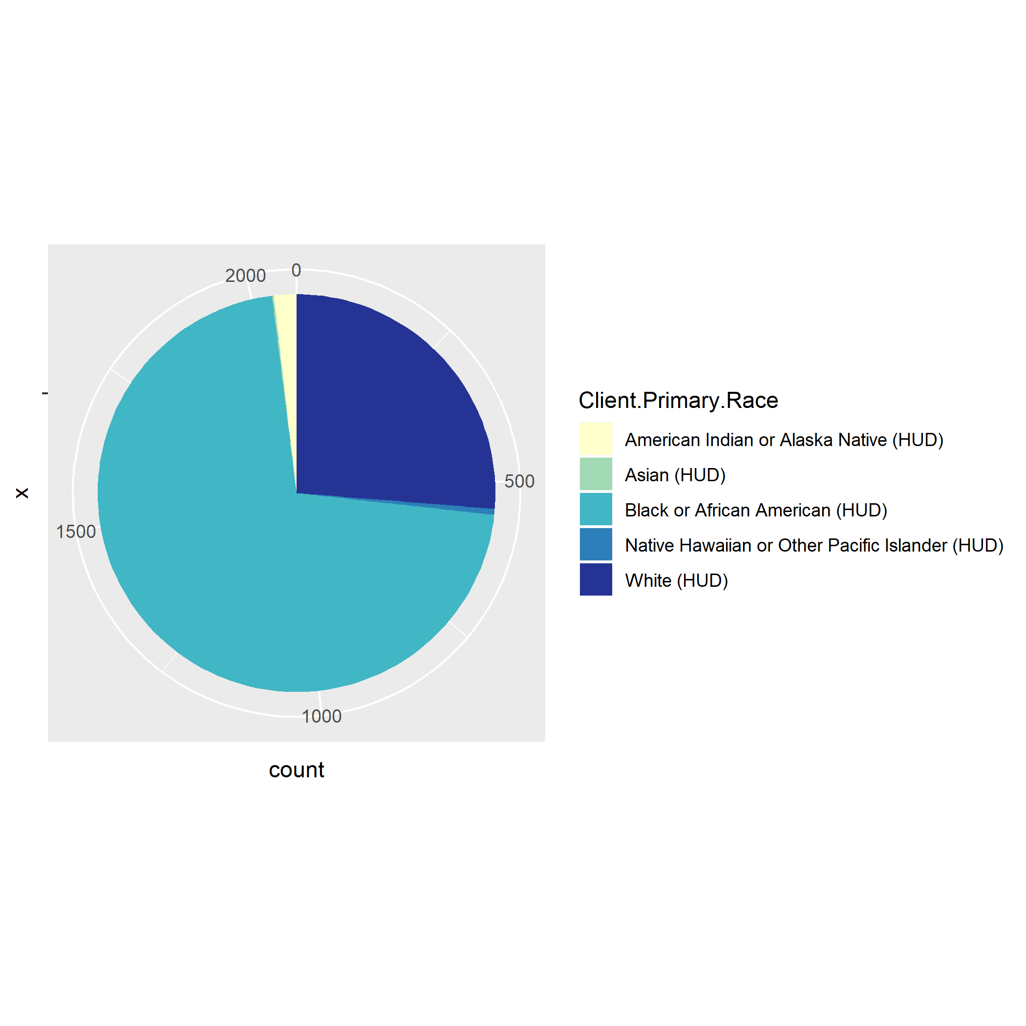
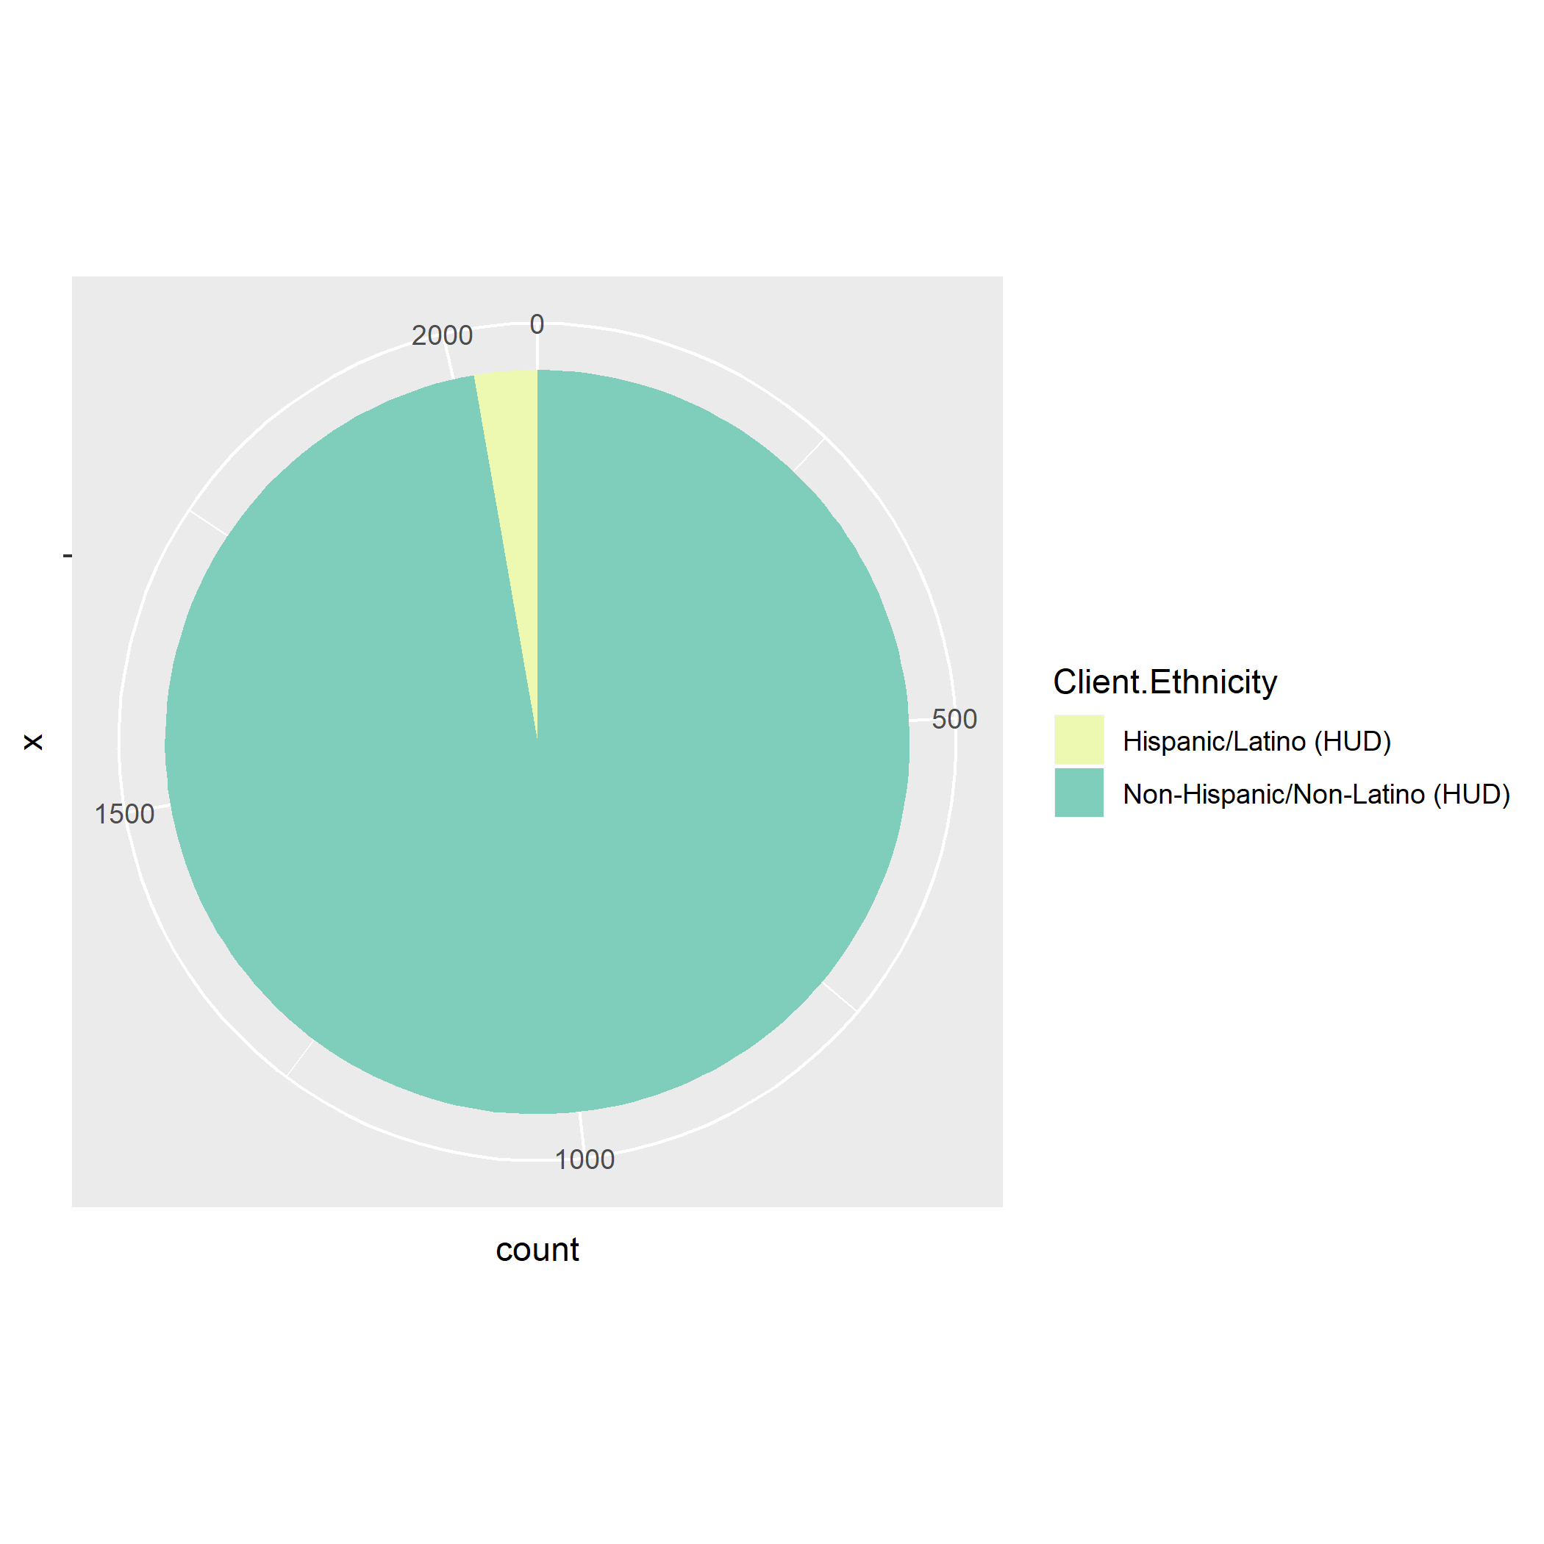
Demographics - Race & Ethnicity
As for primary race of clients, nearly 75% of clients are black or African American. and nearly 25% of clients are white. Other races like Asian are near to 0 according to the databases. More than 97% of the clients are not Hispanic or Latino.

Slide 7
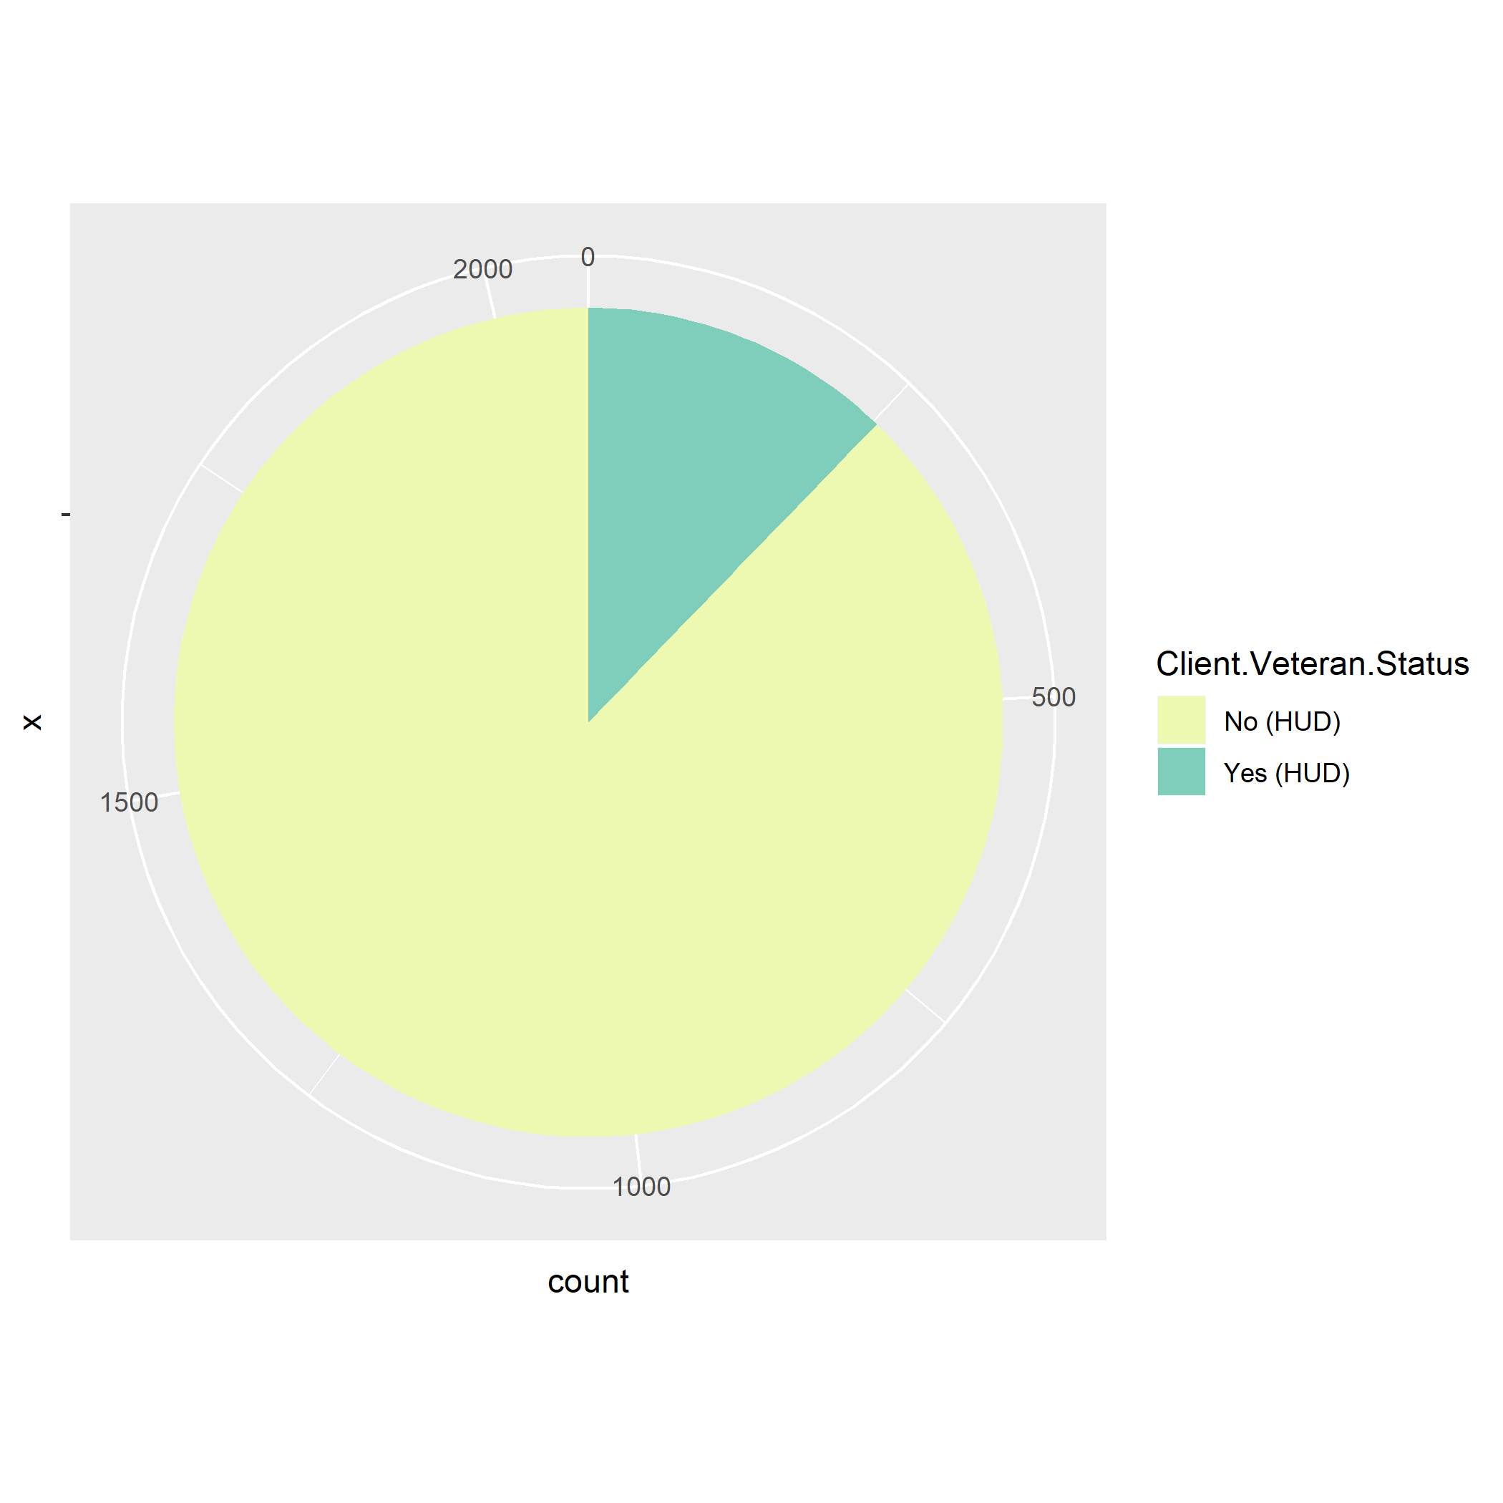
Demographics -Veteran Status
According to data from the Department of Veterans Affairs, there were around 20.4 million U.S. veterans in 2016, representing less than 10% of the total U.S. adult population. Based on our datasets, 12.2% of the clients are veterans.

Slide 8
Demographics - Health Insurance & Income
Only less than 2% of the clients have health insurance. Less than 1% of the clients have income. This almost keeps unchanged before and after being served by the UMD. The distributions of insurance types and the income resources also keep unchanged before and after being served by the UMD.

Slide 9
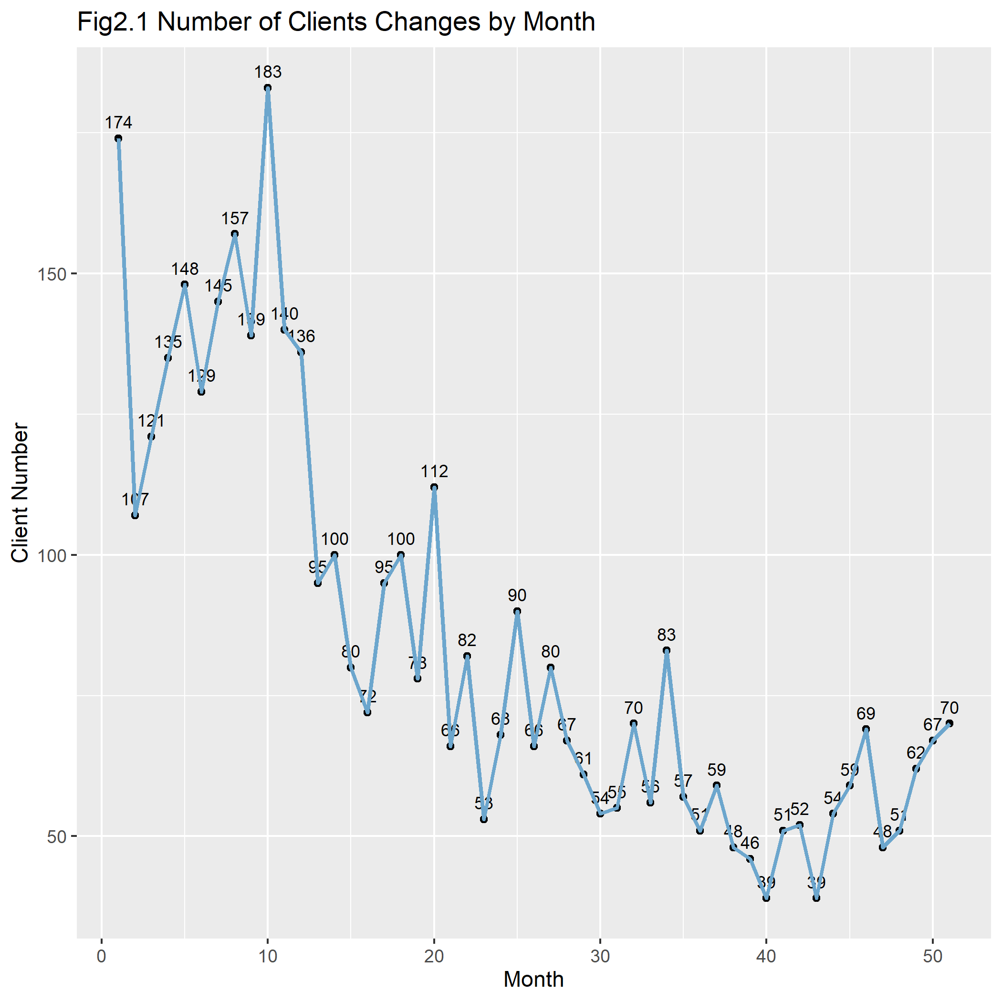
Entry and Exit - New Clients Monthly
The figure shows numbers of new clients every month from August 2015 to October 2019. The peak is in May 2016 with 183 new clients. From then on, the number of new clients decreased to around 70. However, it increased a little bit in the past few months since June 2019. The average new client number monthly in 2019 is 57.1.

Slide 10
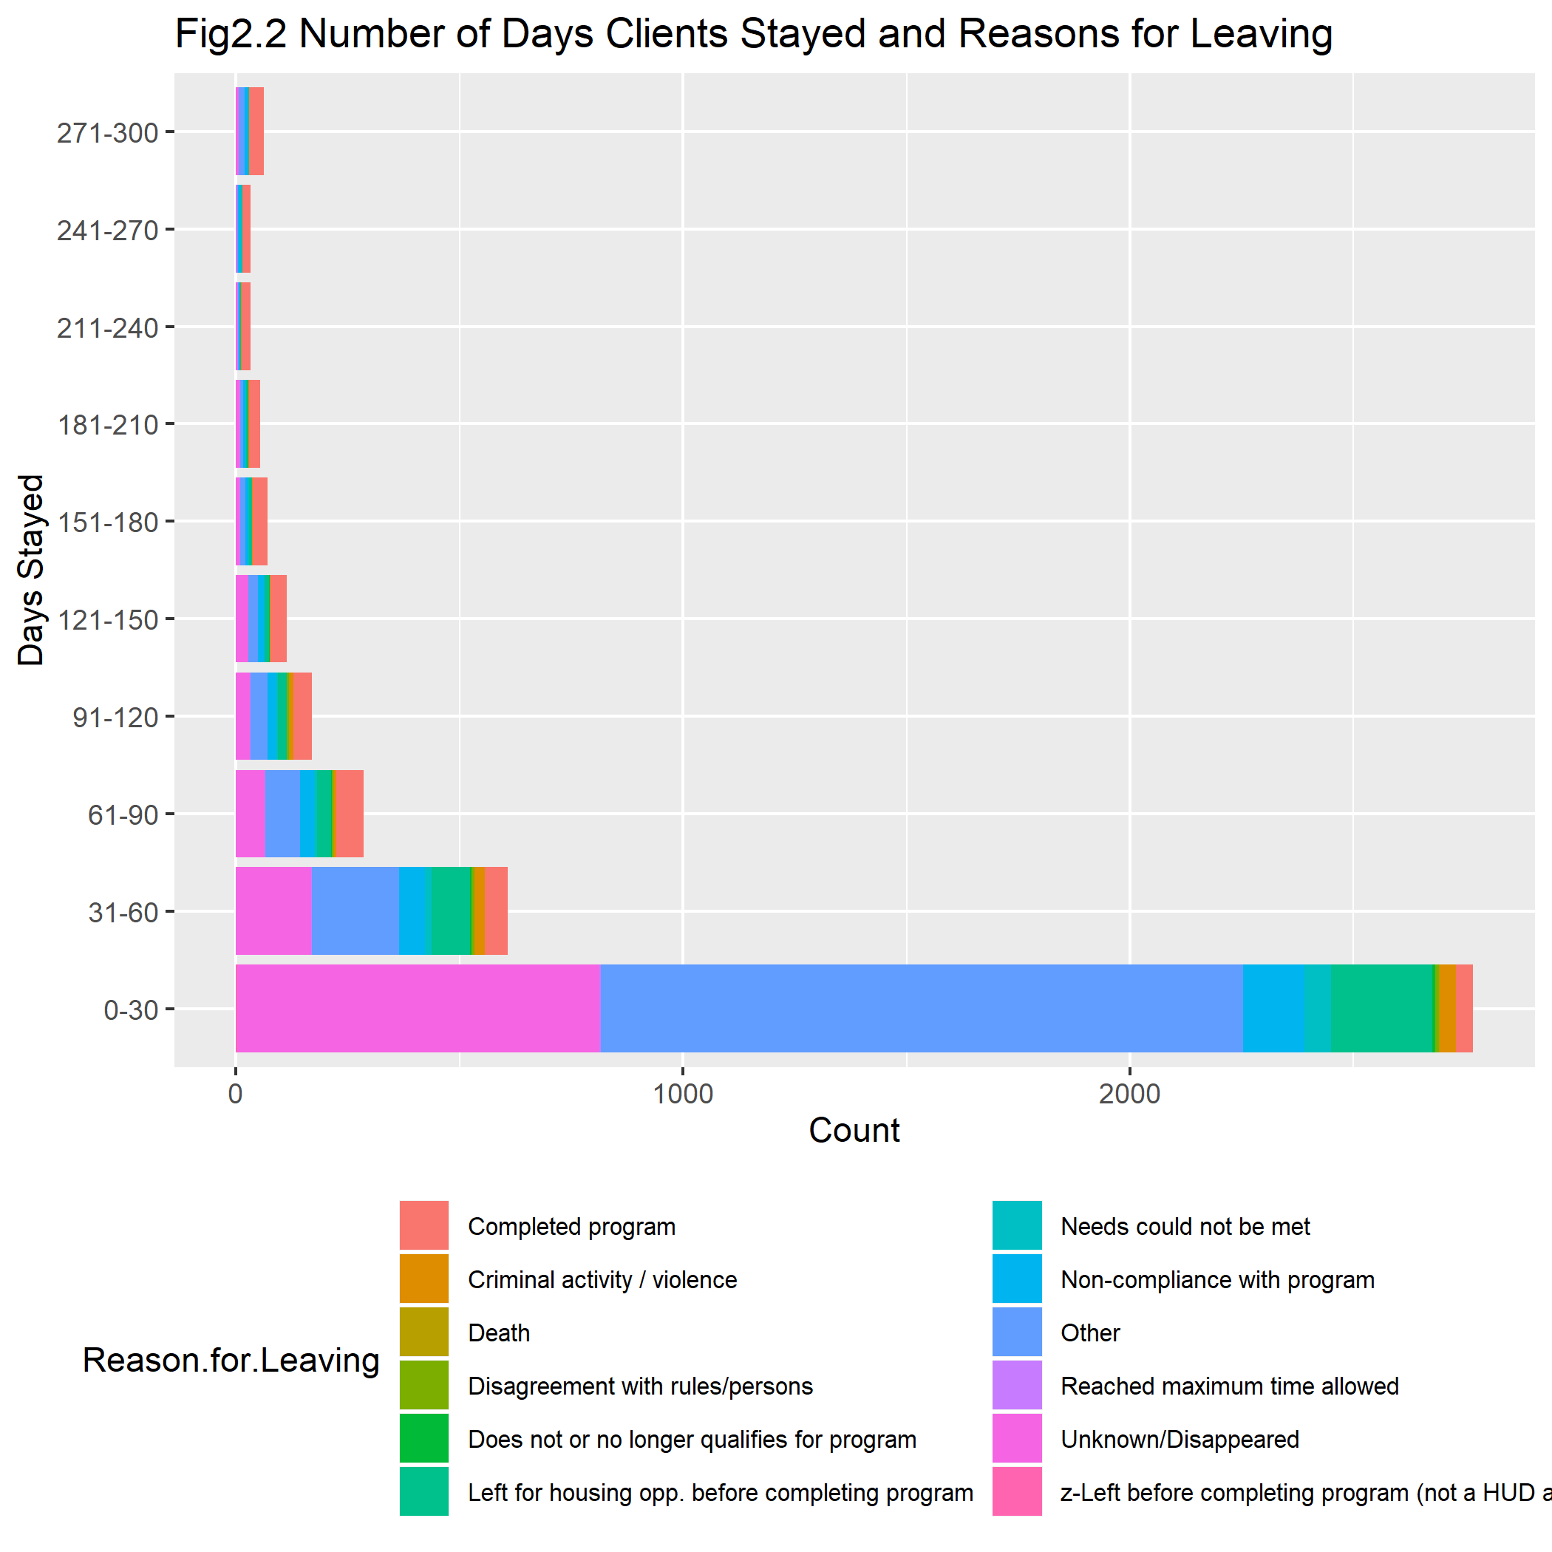
Entry and Exit - Stay and Reasons
The figure shows number of days clients stayed at the UMD and the reasons why they left. We can see that most of the clients stayed less than 30 days, which is more than 4 times of number of clients who stayed 31-60 days. The most common reasons for leaving are "Other" "Unknown/Disappeared", which suggests we need more precise data about reasons for leaving. Besides, "Left for housing opportunities before completing program" is the most popular reason we know.

Slide 11
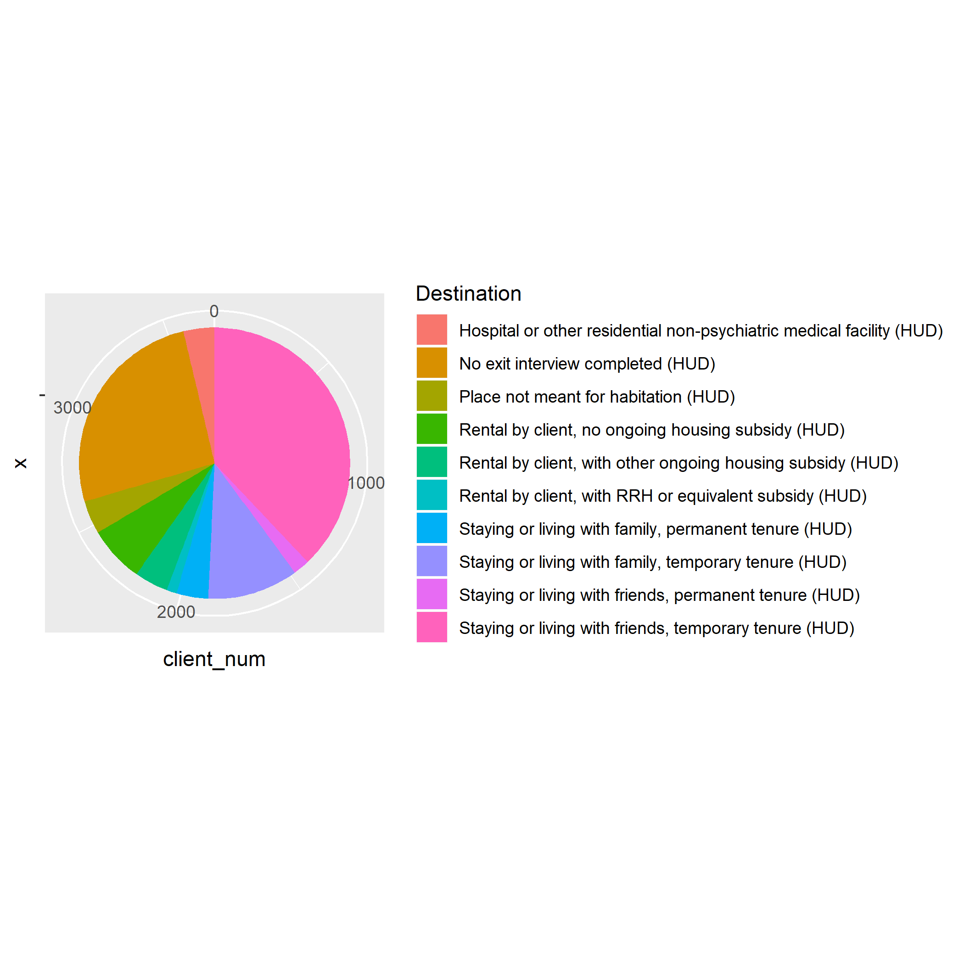
Entry and Exit - Destinations
According to the figure, about one third of clients stay or live with friends with temporary tenure after leaving the UMD. About one fourth of clients did not complete exit interview. About 11% clients stay or live with family with temporary tenure after leaving the UMD. These are the top three destinations after leaving.

Slide 12
Conclusions
Totally, there are 2,075 individual clients were served by the UMD from August 2015 to October 2019. Men are more than women in the client population and ages varies from 18 to 80. Most of clients are 40-60 years old at entry.
Nearly 75% of clients are black or African American. More than 97% of the clients are not Hispanic or Latino.
12.2% of the clients are veteran, which is higher than the percentage on a national scale.
From May 2016 to now, the number of new clients decreased from 183 to around 70. However, it increased a little bit in the past few months since June 2019.
Most of the clients stayed less than 30 days, which is more than 4 times of number of clients who stayed 31-60 days.
“Staying or living with friends, temporary tenure”,“No exit interview completed” and “Staying or living with family, temporary tenure” are the top three destinations of clients after leaving the UMD.

Slide 13
Thanks!

